Slide 1
Gender Equality Clothesline Activity (edit to your own title)
Notes:
Set up of the room, include 1800 respect or other safety contacts cards in the room. Visioning questions ready. T-shirts and textas. Food, drinks. Make it a fun, colourful, friendly space in whatever way you decide.

Slide 2
Acknowledgement of Country
Notes:
-Acknowledgement of Country
I would like to acknowledge the Traditional Owners of the land on which we meet today, the Wurundjeri People of the Kulin Nation.
I would also like to pay my respects to Elders past, present and emerging and pay respects to and welcome all Aboriginal and Torres Strait Islander Community members here today.

Slide 3
What are we doing today?
Notes:
: 5 minutes
A Quick intro to what we are all here for today, before we go to introductions from everyone around the room,
House keeping

Slide 4
Introductions Who are we? Where are we from?
Notes:
Everyone introducing
(adapt to the group context. Add questions if you like about why people are here, what drives them in wanting to discuss gender equality etc.)

Slide 5
Creating our Shared Space: Group Agreement
What is important…
…to feel safe and comfortable in our conversations today?
Notes:
An important part of preparing for our work together and our conversations today is having a comfortable space where each of us feel able to share, listen and take what we need away from the session. Adapt this depending on whether the group is one that know each other well or not. If they know each other well it may be a reminder of things they already use, or a quick conversation about key principles such as respecting private information outside of here.
To start we will work on our shared agreement for making that shared space.
I invite you to take a minute to consider and write down one or more thing that is important for you to participate, feel safe and comfortable. .
Now if people can just call them out, what have people come up with. Facilitators check that they have had a chance to consider some of the following.
Confidentiality: respecting people’s stories
Participating
Passing if not wanting to participate
Hearing from others
Respecting differences in ideas
We may not always agree, challenging ideas but not people.
Also, as part of keeping us on time, we will sometimes need to, as facilitators move discussion along. To help that, if there are things that need further discussion, are questions for us to get back to later, or ideas we need to hold for the project, we will be putting those on the parking bay so we can get back to the work without losing those things.
After the activity: before we move onto the information presentations about gender equality today, I will introduce Brianna who will also talk more about creating a safe space for our conversations today.

Slide 6
Notes:
Have 1800 respect or safety cards on the table and refer to them here.
1800 respect, free confidential counselling service available 24/7 for everyone (victim-survivors, concerned friends or family members or practitioners)
Acknowledge the experience in the room
Recognise that their may be people in the room who have or had experienced FV
Self-care, take breaks
As facilitators we encourage you to leave if you need a break. A simple sign we use in groups is Thumbs up or down to the facilitator where thumbs down says that you may need someone to check in on you.
If you need support, please chat to (have someone who is confident and feels comfortable being in this role of check in) in the breaks –
Support cards in your packs

Slide 7
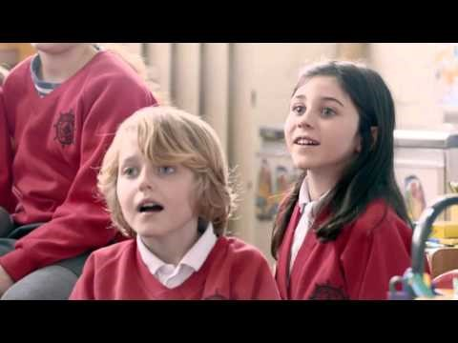
Video
Notes:
This could be a video you use: Redraw the Balance
2:07
Allow time for Group discussion.
https://www.youtube.com/watch?v=qv8VZVP5csA

Slide 8
Like a Girl
https://www.youtube.com/watch?v=XjJQBjWYDTs
Notes:
This is another video you could use (see the redrafted video list for more ideas and adapt to the group with the aim of inspiring them in areas where gender equality is relevant to the things in their life or work or an area of the community the house wants to focus on)

Slide 9
Discussions
Reflection/discussion
What did the video raise for you?
Visioning Question
Notes:
15 minutes
I am going to now ask everyone to take 3 minutes to reflect on what that video meant for you, what it connects to in you, including beliefs, ideas, worries. Write down those reflections on sticky notes. 3 minutes
Visioning questions may include: What changes do you want to see in the community as part of achieving gender equality
Then people sharing what they found in their reflections.
If staying in the big group: it will be people sharing what they found in their reflections. If broken into smaller groups: giving them 10 minutes in the smaller groups to each share what it raised for them.

Slide 10
Now Create your T-shirts
An action or message you want to promote
Notes:
Create t-shirts.
Share them with each other.
Put them up for display in the house.
During 16 days, add one new t-shirt for each day and make sure that message is shared in different ways: photos on facebook. Stories about the person who wrote the message and why it is important to them (if they are happy to share this)

Slide 11
Reflection: Write/talk about any reflections, ideas, actions you want to take with you
Notes:
15 minutes
Visioning question:

Slide 12
Next steps
Notes:
Include reference to evaluation/feedback from the workshop
Include discussion of any actions that people as individuals have wanted to take and whether these might suggest areas that the house or other partners in this project can support community action in the future.
Encourage people to give their details if they are interested in staying in touch with different areas of action for gender equality in the future.

Slide 13
Check Out Activity
A picture/ word:
How you are feeling now
Notes:
It can be to just let everyone say a word about how they feel right now or if you have picture cards. They choose on.
A picture that represents how they feel at this point in time.
Describing in one word.
Remember to give out and receive back evaluation forms
Remember to fill in your own session summary/reflection sheet.

